Slide 1
DeepSci 2017
DEEP LEARNING FOR MEDICAL IMAGE PROCESSING
Mr. R. Vinayakumar (Research Scholar)
Mrs. V. Sowmya (Assistant Professor)
Dr. K. P. Soman (Professor & Head)
11-11-2017.

Slide 2
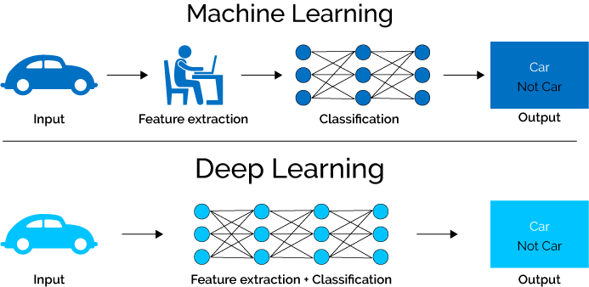
DeepSci 2017
WHY DEEP LEARNING?
DEEP LEARNING FOR MEDICAL IMAGE PROCESSING

Slide 3
DeepSci 2017
WHY DEEP LEARNING FOR MEDICAL DIAGNOSIS?
Deep Learning is a Black Box, but Health Care Won’t Mind
New algorithms are able to diagnose disease as accurately as expert physicians
-Monique Brouillette , MIT Technology Review , April 2017.
DEEP LEARNING FOR MEDICAL IMAGE PROCESSING

Slide 4
DeepSci 2017
INTRODUCTION-MICROSCOPY DIAGNOSIS
* Low-resources
CHALLENGES:
Skilled Technicians
Critical Shortage
CONSEQUENCES:
error –prone
economic burden of buying unnecessary drugs
DEEP CNN FOR MICROSCOPY BASED POINT OF CARE DIAGNOSTICS – John A. Quinn et al., ICMLHC, 2016.

Slide 5
DeepSci 2017
MOTIVATION
Common resources: Microscopes and smartphones.
Automation with computer vision methods.
DEEP CNN FOR MICROSCOPY BASED POINT OF CARE DIAGNOSTICS – John A. Quinn et al., ICMLHC, 2016.

Slide 6
DeepSci 2017
OBJECTIVE
Development of point-of-care (POC) diagnostics which utilize two relatively common resources: microscopes and smartphones.
DEEP CNN FOR MICROSCOPY BASED POINT OF CARE DIAGNOSTICS – John A. Quinn et al., ICMLHC, 2016.

Slide 7
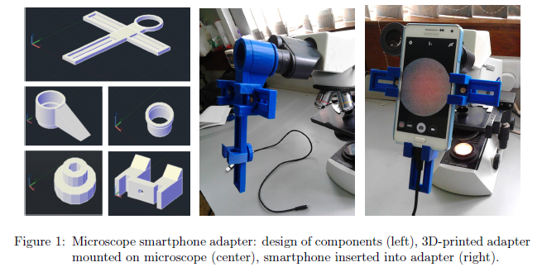
DeepSci 2017
HARDWARE DESIGN
Hardware Design
DEEP CNN FOR MICROSCOPY BASED POINT OF CARE DIAGNOSTICS – John A. Quinn et al., ICMLHC, 2016.

Slide 8
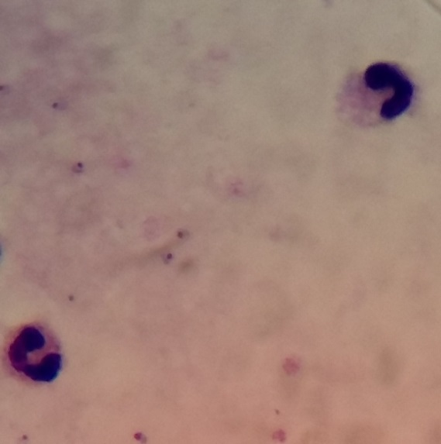
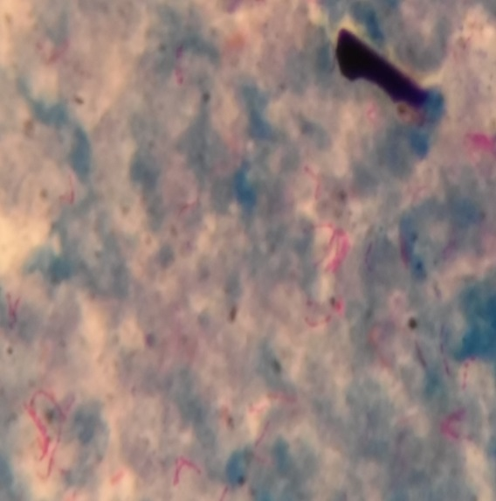
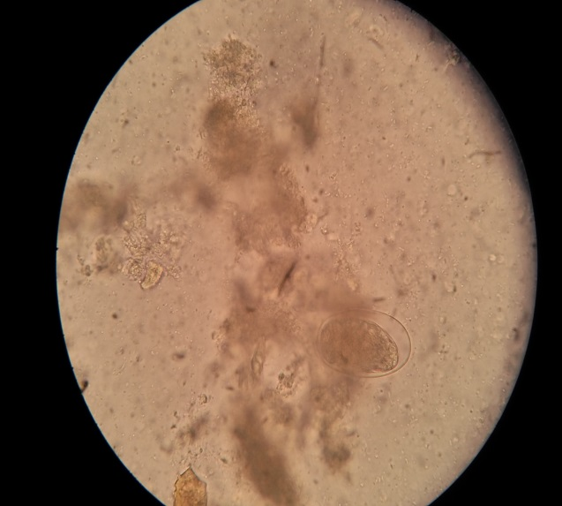
DeepSci 2017
DATASET
Malaria (ML)
Tuberculosis (TB)
Intestinal parasites (IP)
7245 patches in 1182 images
3734 patches in 928 images
162 patches in 1217 images
DEEP CNN FOR MICROSCOPY BASED POINT OF CARE DIAGNOSTICS – John A. Quinn et al., ICMLHC, 2016.

Slide 9
DeepSci 2017
Architecture
Input
Convol 1
Max Pool 1
Convol 2
FC
Output
Filter 1
Filter 2
DEEP CNN FOR MICROSCOPY BASED POINT OF CARE DIAGNOSTICS – John A. Quinn et al., ICMLHC, 2016.

Slide 10
DeepSci 2017
Architecture
M x M x 3
C1 x C1 x N1
P x P x N1
C2 x C2 x N2
FC
Output
N1 - F1 x F1 x 3
N2 – F2 x F2 x N1
C1 = ( (M-F1+2Z)/S1)+1
P1 = C1/PS
C2 = ( (P-F2+2Z)/S2)+1
DEEP CNN FOR MICROSCOPY BASED POINT OF CARE DIAGNOSTICS – John A. Quinn et al., ICMLHC, 2016.

Slide 11
DeepSci 2017
Architecture – TB & ML
20 x 20 x 3
18 x 18 x 7
9 x 9 x 7
8 x 8 x 12
100
2
7 - 3 x 3 x 3
12 – 2 x 2 x 7
C1 = ( (20-3+0)/1)+1
P1 = 18/2
C2 = ( (9-2+0)/1)+1
DEEP CNN FOR MICROSCOPY BASED POINT OF CARE DIAGNOSTICS – John A. Quinn et al., ICMLHC, 2016.

Slide 12
DeepSci 2017
CONVOLUTION
DEEP CNN FOR MICROSCOPY BASED POINT OF CARE DIAGNOSTICS – John A. Quinn et al., ICMLHC, 2016.

Slide 13
DeepSci 2017
CONVOLUTION
DEEP CNN FOR MICROSCOPY BASED POINT OF CARE DIAGNOSTICS – John A. Quinn et al., ICMLHC, 2016.

Slide 14
DeepSci 2017
CONVOLUTION
DEEP CNN FOR MICROSCOPY BASED POINT OF CARE DIAGNOSTICS – John A. Quinn et al., ICMLHC, 2016.

Slide 15
DeepSci 2017
CONVOLUTION
CS231n: Convolutional Neural Networks for Visual Recognition.
DEEP CNN FOR MICROSCOPY BASED POINT OF CARE DIAGNOSTICS – John A. Quinn et al., ICMLHC, 2016.

Slide 16
DeepSci 2017
Architecture – TB & ML
20 x 20 x 3
18 x 18 x 7
9 x 9 x 7
8 x 8 x 12
100
2
7 - 3 x 3 x 3
12 – 2 x 2 x 7
DEEP CNN FOR MICROSCOPY BASED POINT OF CARE DIAGNOSTICS – John A. Quinn et al. ICMLHC, 2016.

Slide 17
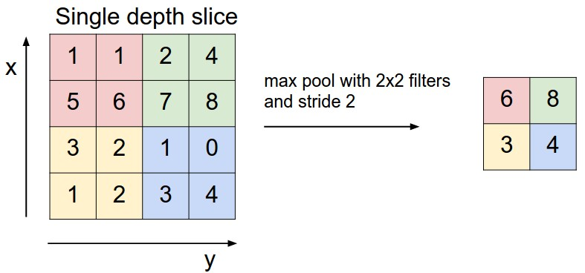
DeepSci 2017
Architecture – TB & ML
CS231n: Convolutional Neural Networks for Visual Recognition.
DEEP CNN FOR MICROSCOPY BASED POINT OF CARE DIAGNOSTICS – John A. Quinn et al. ICMLHC, 2016.

Slide 18
DeepSci 2017
DATASET – Test
Malaria (ML)
Tuberculosis (TB)
Intestinal parasites (IP)
Train & Test – 50%
+ samples were augmented 7 times the original by flipping & rotating the patches
- Samples – 100 times the number of ‘+’ samples.
2,61,345 patches (11.3% -> +)
3,15,142 patches (9.0% -> +)
2,53,503 patches (0.4% -> +)
DEEP CNN FOR MICROSCOPY BASED POINT OF CARE DIAGNOSTICS – John A. Quinn et al., ICMLHC, 2016.

Slide 19
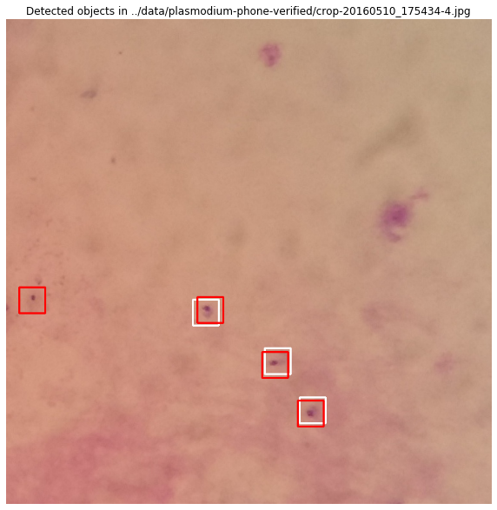
DeepSci 2017
Sample Result-Malaria
White box- labelled by an expert
Red box- Detected by the machine
DEEP CNN FOR MICROSCOPY BASED POINT OF CARE DIAGNOSTICS – John A. Quinn et al. ICMLHC, 2016.

Slide 20
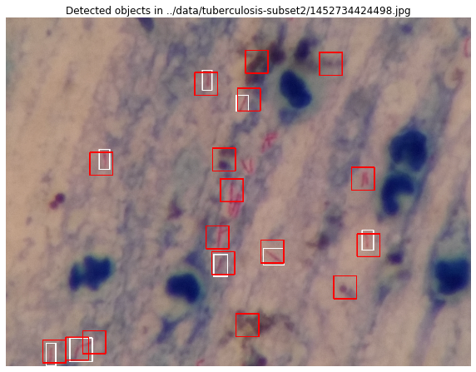
DeepSci 2017
Sample Result-Tuberculosis
White box- labelled by an expert
Red box- Detected by the machine
DEEP CNN FOR MICROSCOPY BASED POINT OF CARE DIAGNOSTICS – John A. Quinn et al. ICMLHC, 2016.

Slide 21
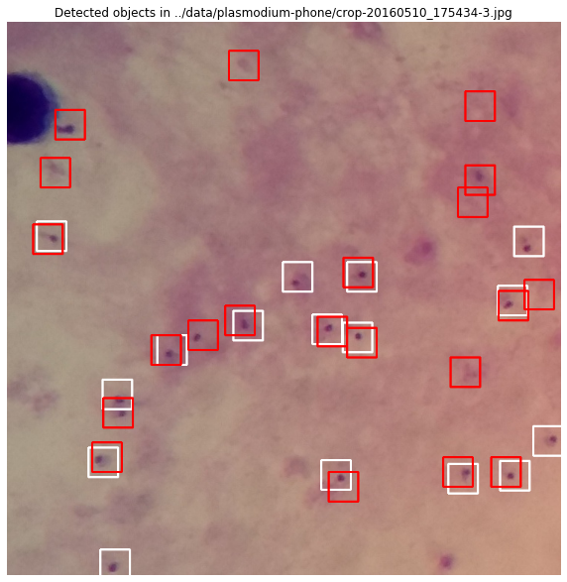
DeepSci 2017
Sample Result-Intestinal Parasites
White box- labelled by an expert
Red box- Detected by the machine
DEEP CNN FOR MICROSCOPY BASED POINT OF CARE DIAGNOSTICS – John A. Quinn et al. ICMLHC, 2016.

Slide 22
DeepSci 2017
Interesting Result-Intestinal
Parasites
DEEP CNN FOR MICROSCOPY BASED POINT OF CARE DIAGNOSTICS – John A. Quinn et al. ICMLHC, 2016.

Slide 23
DeepSci 2017
Summary
Better performance than the hand - engineered features
Flexibility - Same network architecture
Decision support tool
Consistency in diagnosis
DEEP CNN FOR MICROSCOPY BASED POINT OF CARE DIAGNOSTICS – John A. Quinn et al. ICMLHC, 2016.

Slide 24
DeepSci 2017

